Slide 1
Spinner

Slide 2
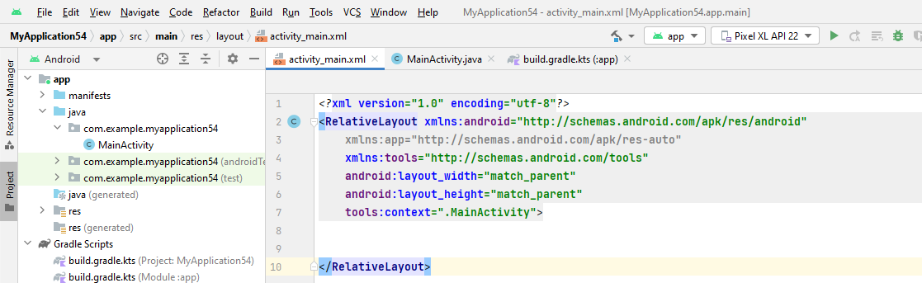

Slide 3
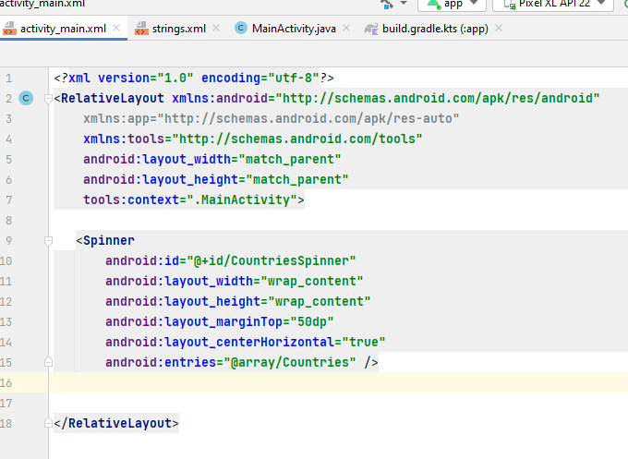

Slide 4
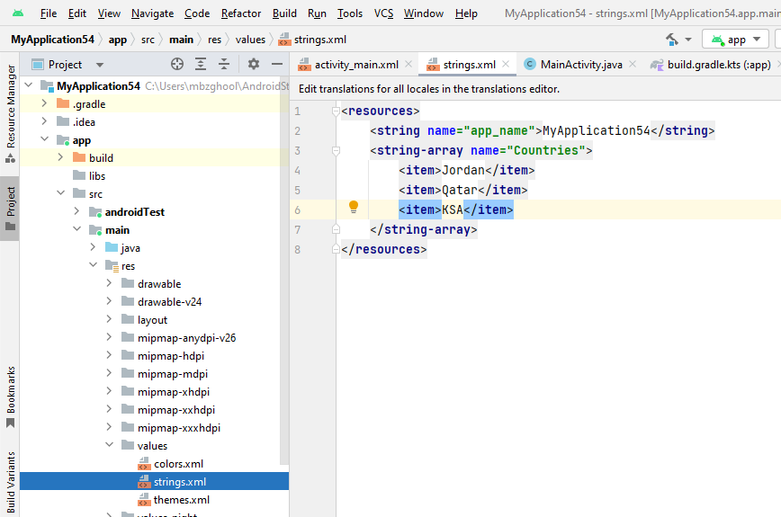

Slide 5
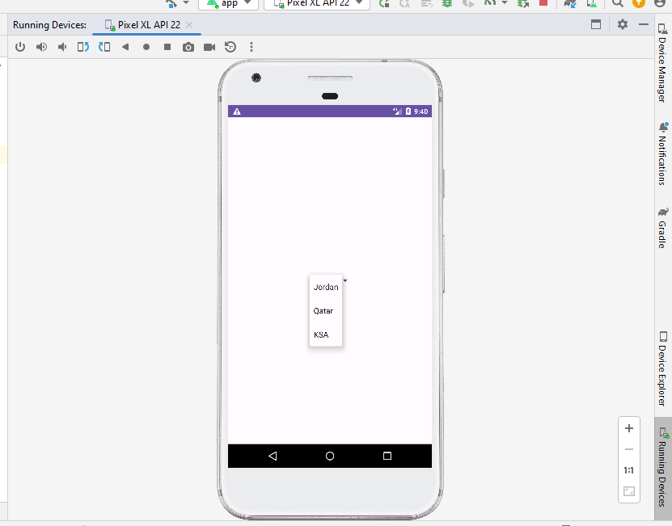

Slide 6
public class MainActivity extends AppCompatActivity { private Spinner countriesSpinner; @Override protected void onCreate(Bundle savedInstanceState) { super.onCreate(savedInstanceState); setContentView(R.layout.activity_main); countriesSpinner = findViewById(R.id.CountriesSpinner);

Slide 7
countriesSpinner.setOnItemSelectedListener(new AdapterView.OnItemSelectedListener() { @Override public void onItemSelected(AdapterView<?> adapterView, View view, int i, long l) { Toast.makeText(MainActivity.this, countriesSpinner.getSelectedItem().toString()+" Selected", Toast.LENGTH_SHORT).show(); } @Override public void onNothingSelected(AdapterView<?> adapterView) { } });

Slide 8
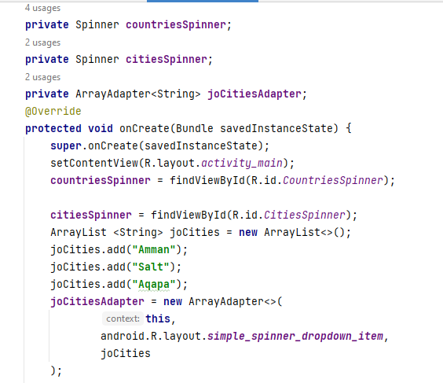

Slide 9
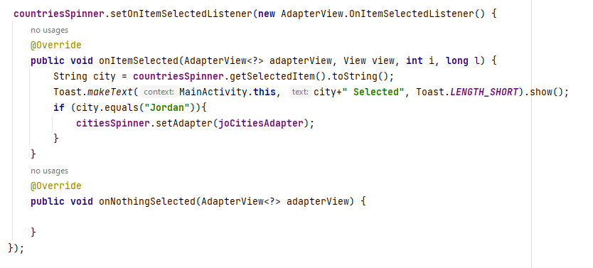

Slide 10
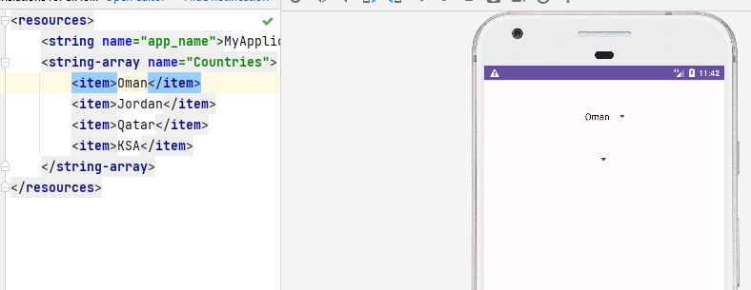

Slide 11
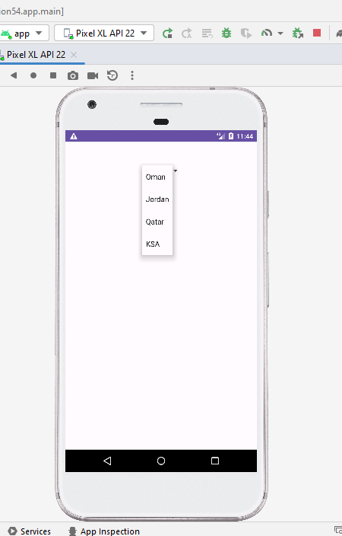

Slide 12


Slide 13
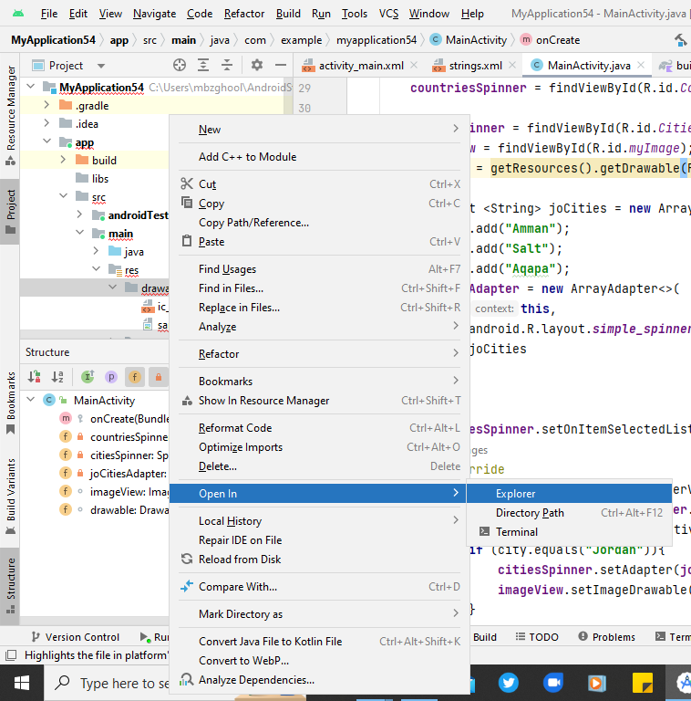

Slide 14
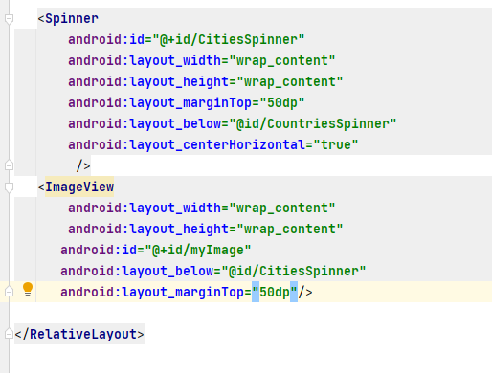

Slide 15
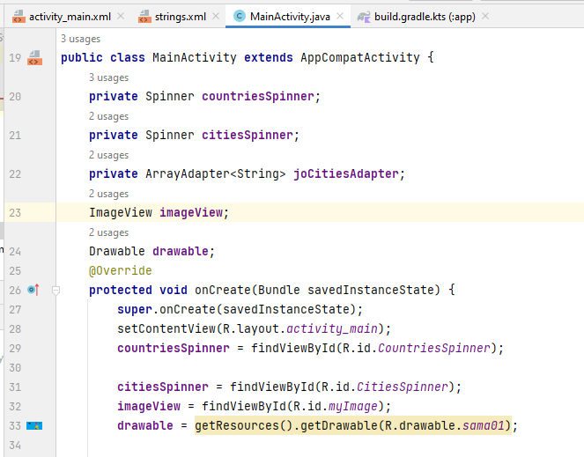

Slide 16
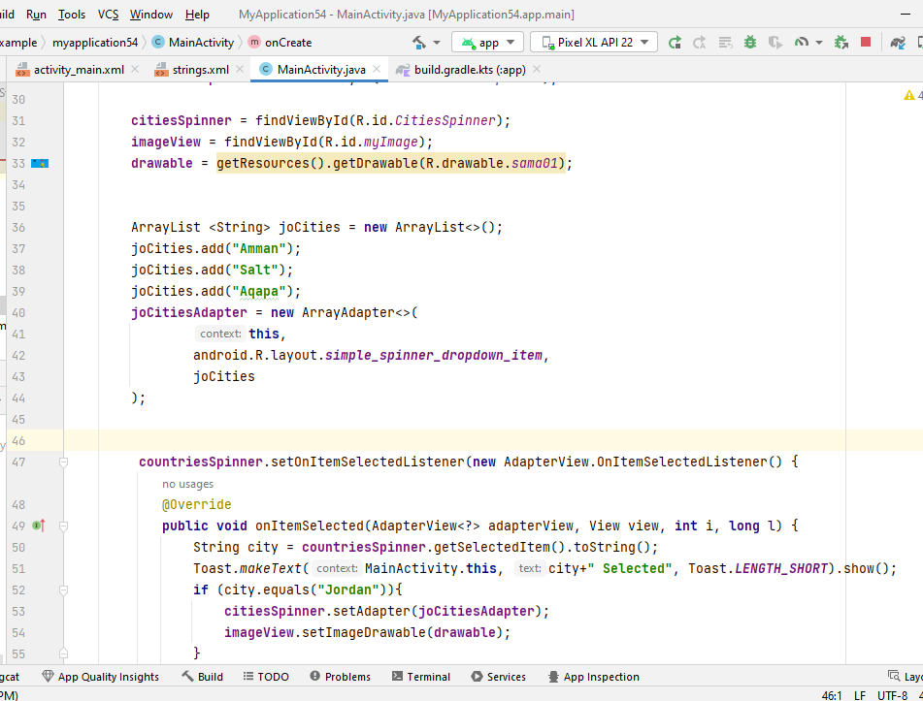

Slide 17
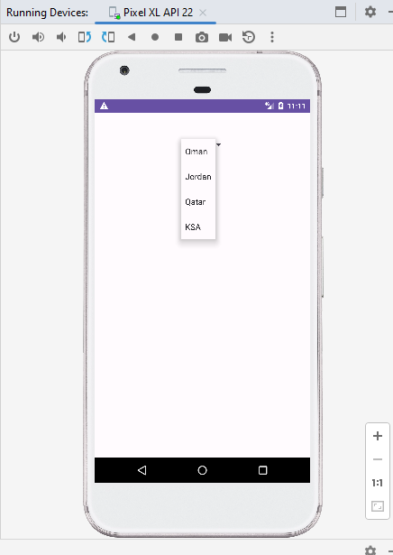

Slide 18
